Slide 1
Verification and validation in MATLAB
Testing and validation platforms
Master’s Degree in Smart Energy Systems

Slide 2
Content
Introduction
Test harness
Test manager

Slide 3
Introduction
1

Slide 4
Introduction
You can use Simulink Test to author, manage, and execute tests for Simulink models and generated code.
The modes in which you can run tests are in-model, software-in-the-loop (SIL), processor-in-the-loop (PIL), and hardware-in-the-loop (HIL).
To run HIL tests, the target computer must have Simulink Real-Time™ installed.

Slide 5
Introduction – Testing approach
Bottom-up approach
Each component is verified separately and integrated in subsystems.
Each subsystem is verified separately and integrated in a system.
System is validated against requirements.

Slide 6
Introduction – Test types
Tests classified depending on the tested component/system.
Test types
Unit tests
Integration tests
Functional tests
Only one component
More than one component
One function

Slide 7
Introduction – Test types (in MATLAB)
Tests classified depending on the inputs and outputs.
Test types
Simulation testing
Requirements validation
Baseline tests
SIL/PIL testing
HIL Real-time testing
Check that what you implemented works properly in simulation (verification).
Check that what you implemented meets requirements.
Compare simulation outputs to baseline data.
Check that the SIL/PIL implementation works as the original MIL simulation.
Check that the implemenation works properly in real time.

Slide 8
Test harness fundamentals
2

Slide 9
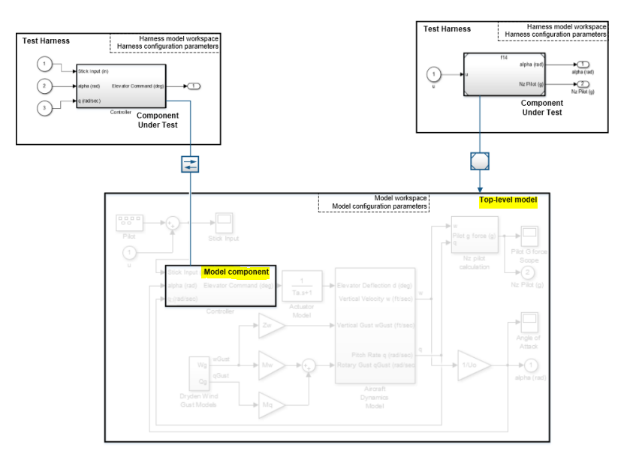
Test harness - definition
A test harness is a model block diagram that you can use to test, edit, or debug a Simulink model.
The test harness contains a separate model workspace and configuration set.
Test harnesses can be created for components or top-level (system) models.
A test harness is a separate file where you test isolated components

Slide 10
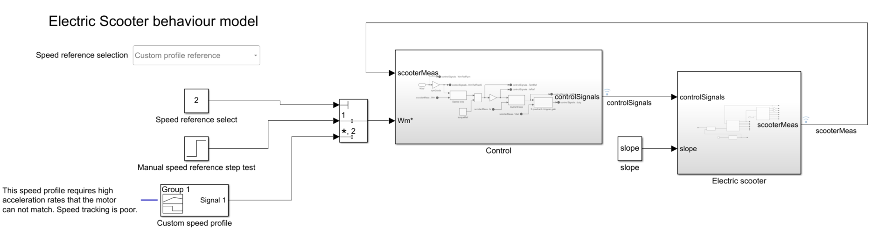
Introduction – Test harness
Let’s practice with a Simulink behavioural model. Open the scooter behavioural model given in the coursework.
\3_PHASE5_Design\behaviouralmodels\mediumFidelityScooterModel.slx

Slide 11
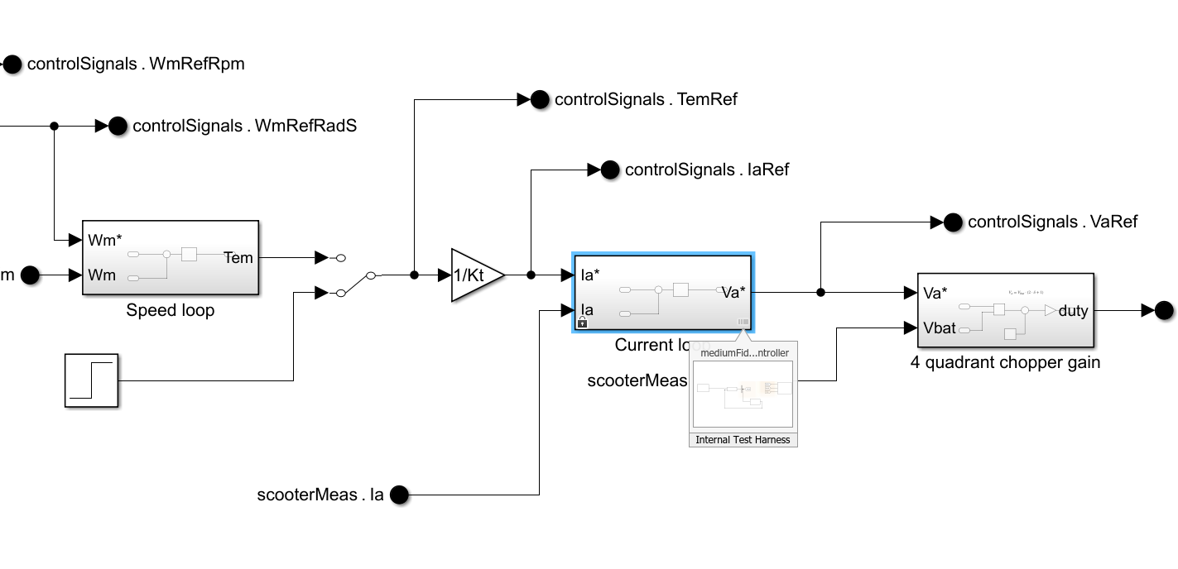
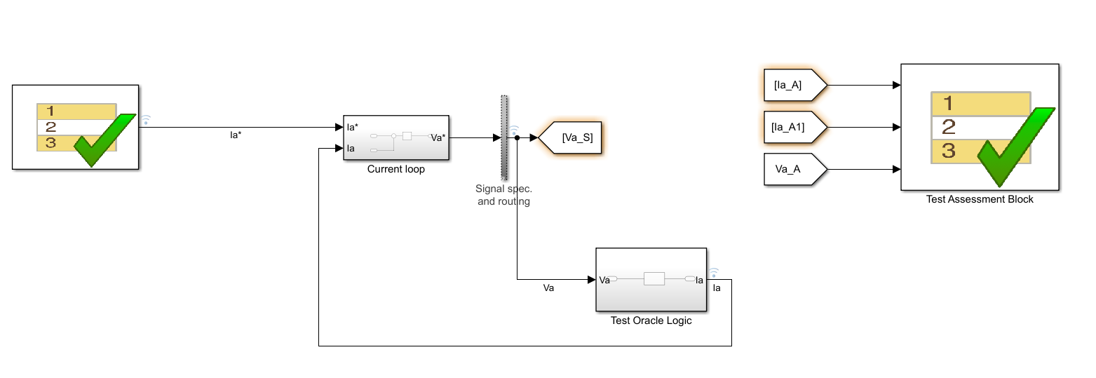
Test harness - example
Control system
Control subsystem = only current loop

Slide 12
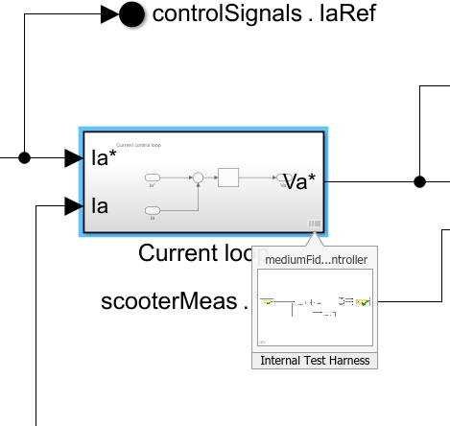
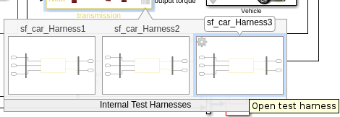
Test harness - storage
When a component has a test harness assigned, it will appear in the right down corner.
A model can have more than one Test Harness.
A test harness can be.
Internal: only accessible from the component. The file is saved internally.
External: files are saved externally and can be used in standalone mode.
A model stores all test harnesses either internally or externally; it is not possible to use both types of harness storage in one model.

Slide 13
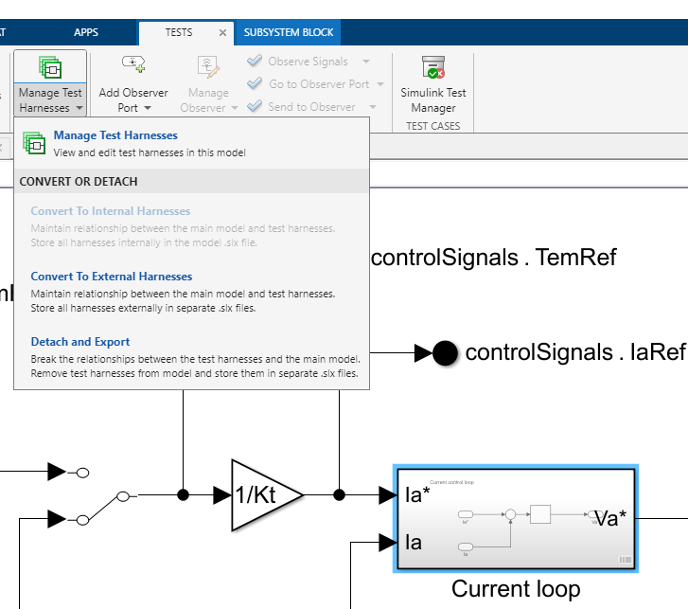
Test harness - management
Test harness of a model can be managed from the Test tab (Simulink Test app).
Test harness can be converted here from internal to external.

Slide 14
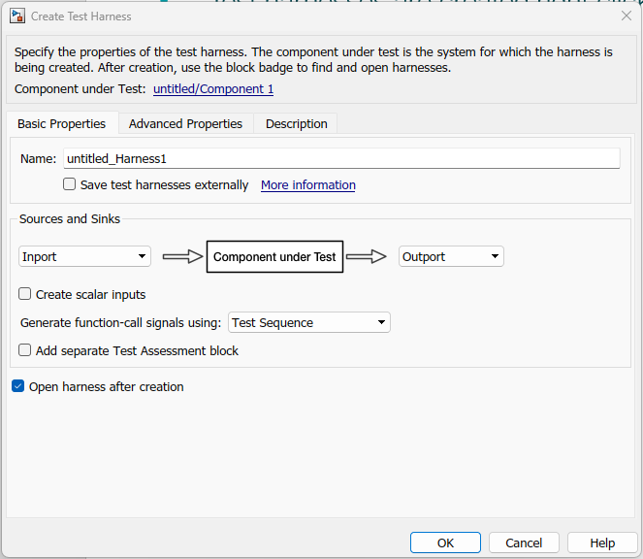
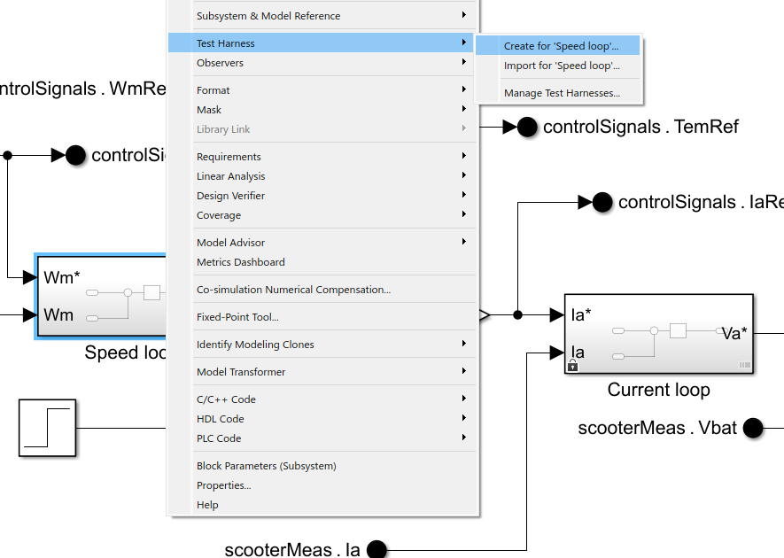
Test harness - creation
Test harnesses are created right clicking on the component.
In the Create Test Harness window, you can select the configuration.
First think which kind of test you wan’t to perform.

Slide 15
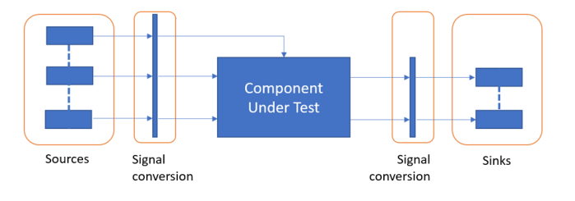
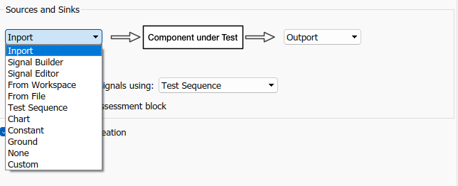
Introduction – Defining inputs
You can author test input vectors (sources) in several ways:
Graphically, such as with the Signal Editor.
From datasets, such as using Excel or MAT files.
As a sequence of test steps that progresses according to time or logical conditions (test sequence).

Slide 16
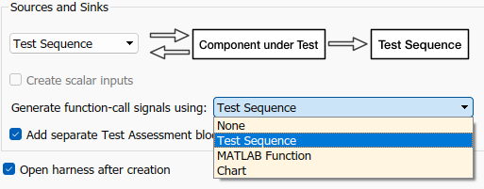
Introduction – Defining assesments
You can define assessments to indicate when functional requirements are not met:
With a structured assessment language.
With verify statements in a Test Assessment or Test Sequence block.
With blocks in the Model block library.
With tolerances you set on the simulation data output.
With a custom criteria script that you author using MATLAB.

Slide 17
Test manager
3

Slide 18
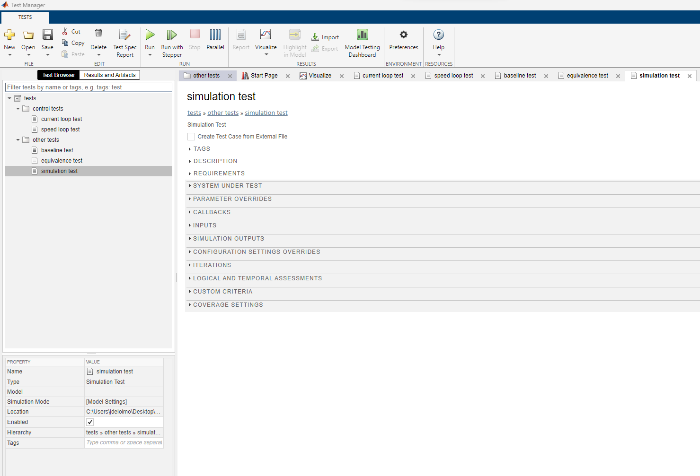
Test manager
Once we have created test harnesses, we can go one by one checking if test results are OK.
Or, we can use the Test Manager. All tests are in the same place and can be launched in batch.
\4_PHASE9_Validation\tests\testFile.mldatx

Slide 19
Organisation of the tests
Run and analyse in the same place
Test file
Test file
Test cases

Slide 20
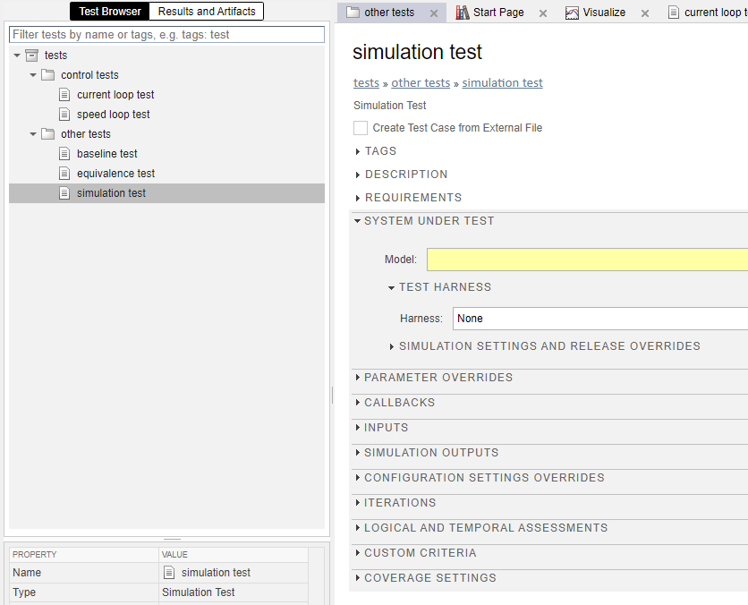
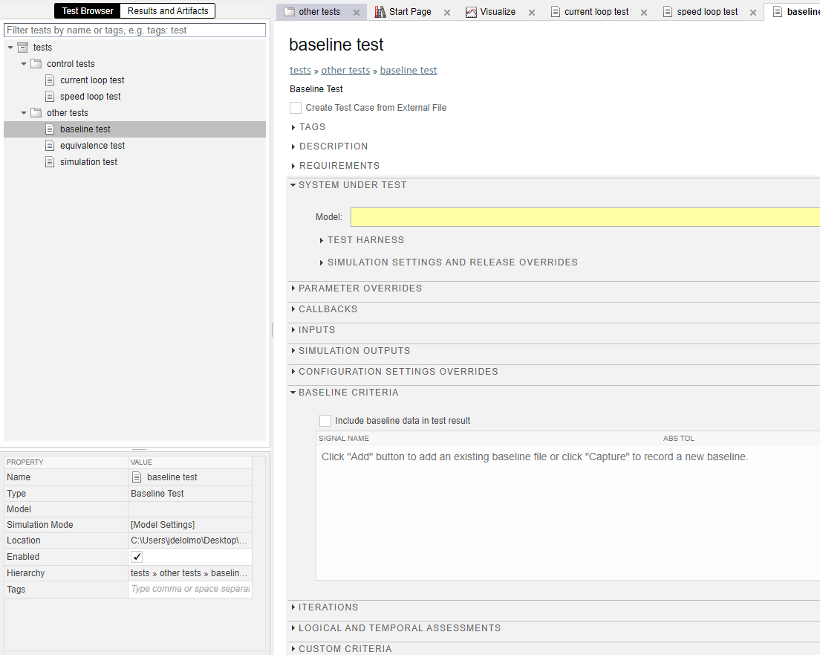
Test types
Load model and harness
Simulation test
Baseline test
Load baseline data (.mat, .xslx,…)
The harness includes the inputs and the assessment block
The output of the simulation is compared to baseline data

Slide 21
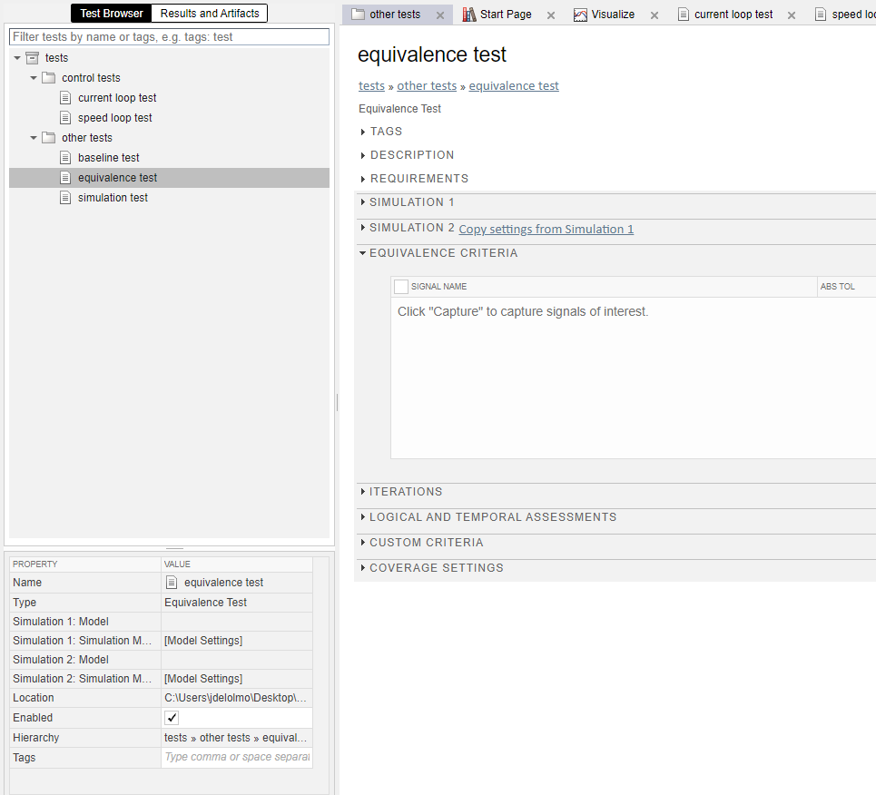
Test types
Load model and harness
Two simulations
Simulation test
Equivalence test
The harness includes the inputs and the assessment block
Compare two simulations

Slide 22
Eskerrik asko
Muchas gracias
Thank you
Jon del Olmo Larrañaga
jdelolmo@mondragon.edu
Iosu Aizpuru
iaizpuru@mondragon.edu
Paul Aretxederreta
x.paretxederreta@mondragon.edu
Galarreta Campus
Jauregi Bailara, z.g.
20120 Hernani (Gipuzkoa)
Tel. : +(34) 943 739765
www.mondragon.edu

